Slide 1
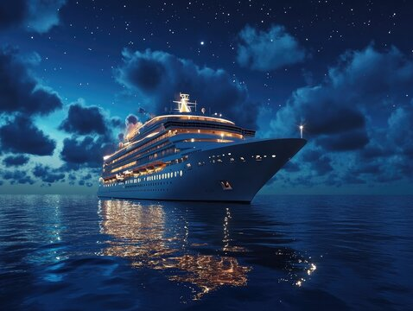
Identifying the hidden dangers And Subsequent Barriers
THAT IMPEDE CRUISE SHIP CRIME VICTIMS’ ACCESS
TO COLLABORATIVE ASSISTANCE AND RESPONSE
International Cruise Victims (ICV)
Notes:
Laurie: Good afternoon: My name is Laurie Dishman, and as the Exec. Vice President of International Cruise Victims, I would like to welcome you all and thank you for joining our workshop today.
Jamie: And I am Jamie Barnett, President of International Cruise Victims (ICV). Laurie and I, along with Georgia Ananias, who was unable to be with us today, but has sent along a copy of her book for each of you to take home with you today, make up the leadership of a very unique 501C3 global victims advocacy organization known as ICV.
So we would like to start off today by asking you all a few really simple questions. So, to begin with ,by a show of hands, how many of you have taken a cruise? Respond briefly, Now, of those who have taken a cruise how many of you were warned of the dangers that were present in the cruise ship environment ,not included muster drill instruction in the event of a fire or a need to abandon ship? okay thank you. Okay, now do any of you have an idea what the number one crime occurring on cruise ships might be? Great. What kind of headlines have you heard or seen recently in the media talking about cruise ships?
Great, thank you so much for sharing. The sad thing is that there are so many other events that Laurie and I feel you should have heard about in the news. So many things the cruise lines don't want you to know. So many things the cruise industry is able to conceal and keep from the public. And that is a large large part of why ICV exists today. We are an all volunteer, unpaid advocacy organization made up of victims, or survivors and families, who then in turn represent and support other victims who have been impacted by crimes and other tragic events at sea.
Jamie: And the reason we are here today is that both Laurie and I are victims of crimes that have occurred on cruise ships.
But we, Laurie, Georgia, and I are only 3 , among the multitudes of victims with tragic stories to tell, however, if you go on our website you will be able to see and discover how similarly all victims are treated by the wealthy, rapacious cruise industry. And that is the main reason we are here today.
. Recently, as many of you may have seen, either our organization itself, or our members’ stories have been prominently featured in the media, most notably on Netflix and on NBC network television, but also in podcasts and TikTok pages too numerous to count. Each have revealed a long-standing pattern of systemic failure of the cruise lines willingness to handle onboard crimes and disappearances and the victims that these tragedies leave in their wake.
Laurie: The stories these series told, both Amy Bradley is Missing and Survival Mode: The Sinking of the Costa Concordia, as well as the others, became opportunities to show the world that these cases are not rare accidents—they are the predictable outcome of a mega-wealthy industry operating with minimal oversight and a lack of true concern for passenger safety and well-being.
So that’s who we are, now lets look into International Cruise Victims as an organization; why and how we came into being and what all we do.

Slide 2

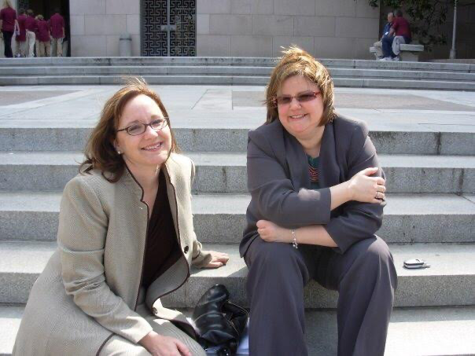
Laurie Dishman and Best Friend Michelle
Notes:
Laurie: That’s right. I was......

Slide 3

Ashley Barnett
1980-2005
Notes:
Jamie: And I lost my daughter Ashley Barnett...

Slide 4


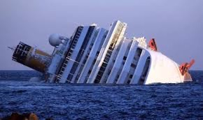
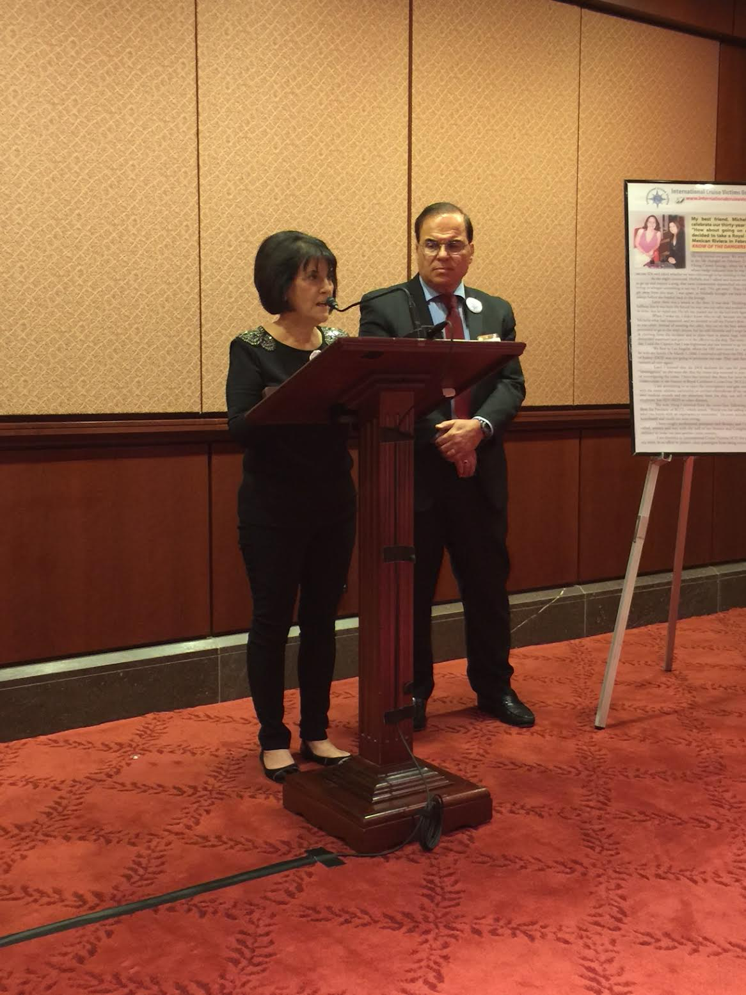
...survived the sinking of the Costa Concordia
GEORGIA ANANAIS AND HER FAMILY TELL HOW THEY.....

Slide 5

Why and How Did ICV come to exist?
Notes:
4 grieving families, having had loved ones go missing from cruise ships under mysterious circumstances, found themselves feeling lost with no where to turn for help, rather like little tiny Davids going up against a huge Goliath; when they were somehow able to come together and go to congress to demand justice, and accountability,. They were filled with conviction that the cruise industry had to be held accountable. Who would ever think that you would have to go to congress to get the kind the kind measures put in place that the hotel industry had for decades prior, like peep holes in cabin doors, security latches, CCTV cameras, defib, and access to independent law enforcement. But they did!
And when these 4 families came together in 2005 a series of congressional hearings focusing on crime aboard cruise ships began. The organization then began to grow as their stories were shared and the media began to take interest.
Laurie: In fact, that’s how I found ICV, through an article in this time mag. And again our organization kept growing in it’s ability to get the attention of congress, growing in its ability to support victims by amplifying their voices just like we are doing here today.

Slide 6
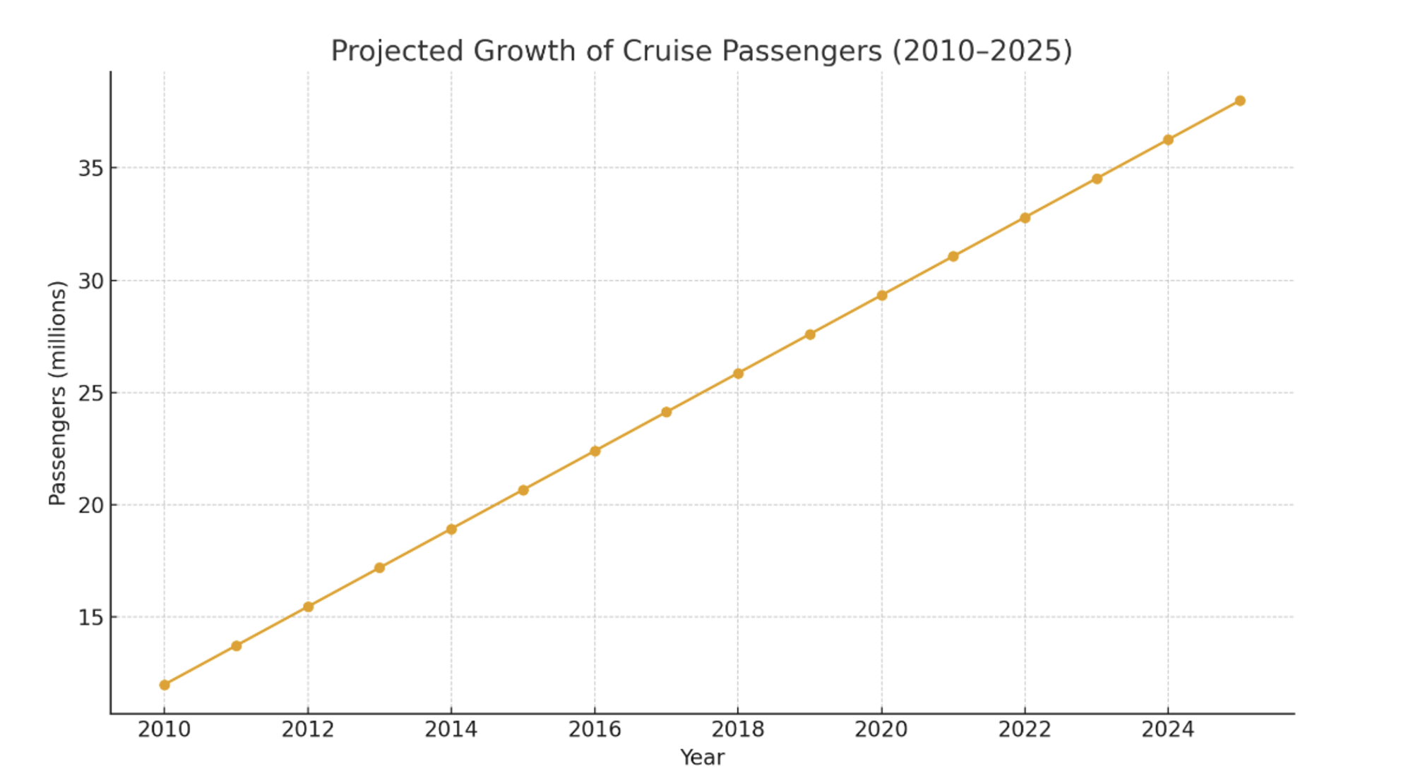
Chart showing growth from 12 mil passengers in 2010 to 38 mil in 2025

Slide 7
The Mission of ICV is Threefold:
to advocate for improved regulations, standards and protocols that ensure the safety of cruise ship passengers,
to increase the public's awareness of the potential risks as well as the rights and protections they are relinquishing to travel on a cruise ship, and…
to provide support for passengers who have been the victims of crime, violence, negligence or other tragedies while on a cruise voyage.
Notes:
Thus ICV was born, born from tragedy—but driven by purpose. And that purpose filled mission is 3-fold...(take turns reading)
Take turns reading the three missions

Slide 8
What we discovered
Cruise lines prioritize profits and image over safety
Few enforceable U.S. or international laws
Oversight is lacking
Victims are left with little or no recourse.
Notes:
The ICV organization became incorporated in 2006 and quickly and shockingly became aware that the cruise industry prioritized profit and image over passenger safety and security. We, like all the rest of the public, were still under the influence of the ads and images we saw daily in the media that promoted nothing but fun and safe passage.
So the more we began
to realize that fact, the more determined we became to shed light on it, and in the process we discovered how few enforceable US laws are able to reach cruise ships regardless of the fact that they are incorporated here, have their headquarters here, passengers buy their tickets here, they board the ships here, and yet passengers are most often totally unaware that the laws that protect them as US citizens do not go with them when they step foot onto their dream vacation ship. Passengers literally have no idea how many rights they are relinquishing when they decide to take a cruise. Sadly, US oversight and enforceable laws seldom reach across the murky jurisdictional waters that lie beyond our US territory.. Without an organization like ICV, victims would still be isolated, ignored, and denied justice.

Slide 9
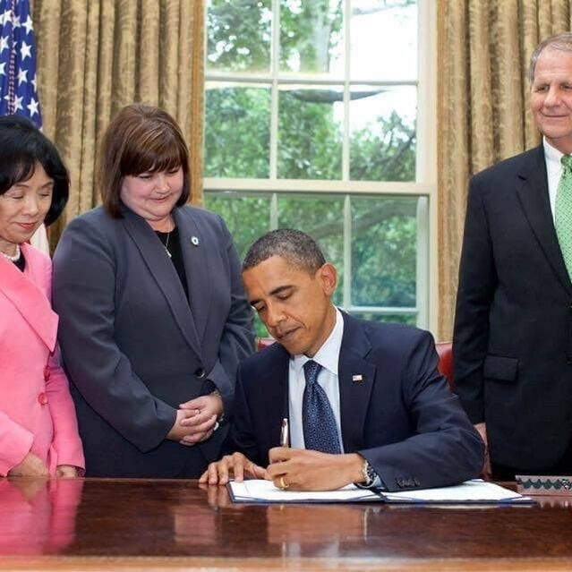
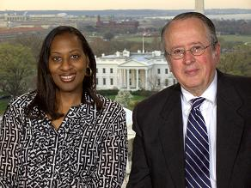
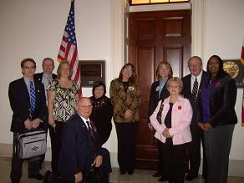
The Cruise Vessel Security and Safety Act of of 2010 is U.S. federal legislation designed to improve the security and safety of passengers and crew on cruise ships. Signed into law by President Obama. the Act introduced a range of measures that cruise ships must implement to comply with the new standards.

Slide 10
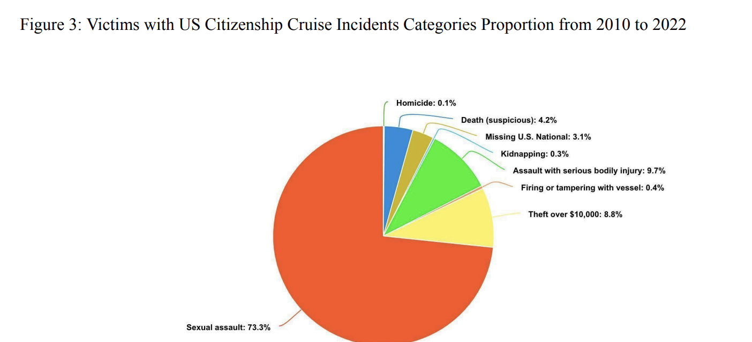
the CVSSA includes
The reporting of Certain Crimes...
1. Sexual Assault
2. Homicide
3. Theft over $10,000
4. Suspicious Death
5. Assault with serious bodily injury
6. Firing or tampering with a vessel
7. Missing US National

Slide 11
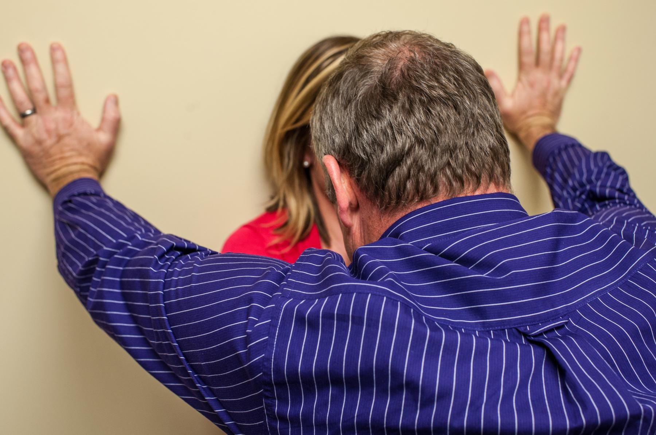
The #1 Crime committed on a cruise ship is sexual assault
33% OF WHICH IS COMMITTED AGAINST MINORS!!!

Slide 12
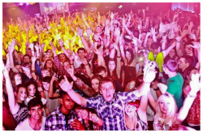
Statistics show that alcohol was involved in.... 62.5% of onboard assaults 36% of sexual assaults While the data suggests that greater concern should exercised regarding responsible serving of Alcohol & curtailing alcohol misuse, however most cruise lines have instead begun to offer “All you Can Drink” packages!

Slide 13
Cruise Vessel Security and Safety Act also Includes...
Structural Changes including peep holes, latches, railing height, Man Overboard systems, L-RAD, Surveillance, Sexual Assault Response.
Provides each US victim with automatic rights to contact FBI and other support organizations
A security guide must be distributed to each passenger
Statistical compilation of the above reported crimes must be maintained by the Department of Transportation
Civil and criminal penalties, including fines and a denial of entry into the US, to be assessed against any vessel in violation of the provisions herein

Slide 14
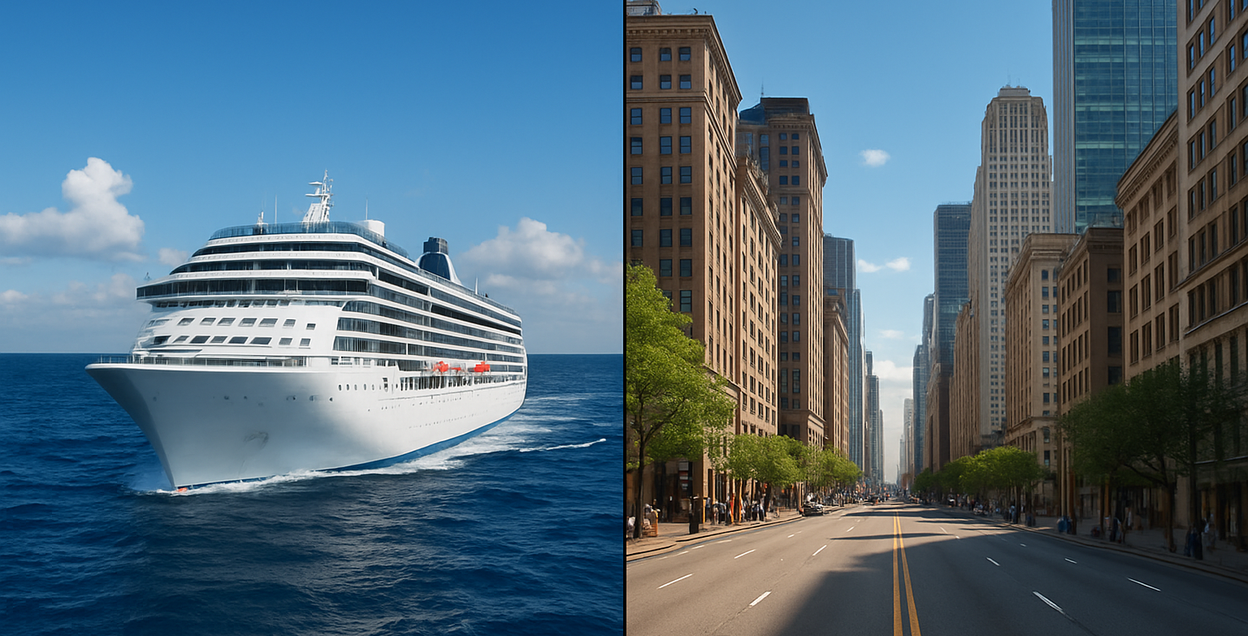
What sets cruise ship crimes and the
victims themselves
apart from those committed on land?

Slide 15
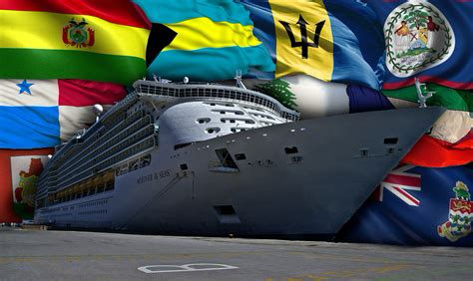
Flags of Convenience Loopholes

Slide 16
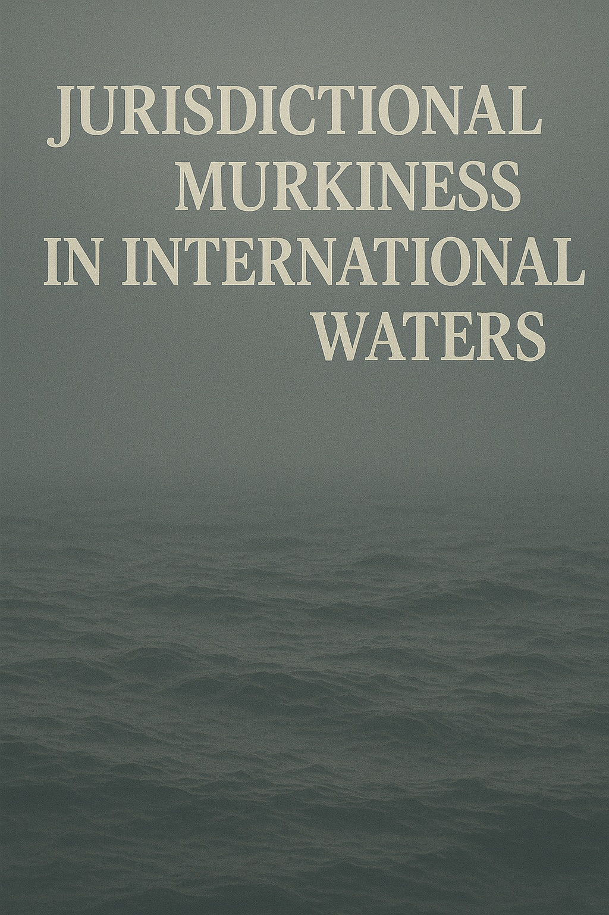

Slide 17

NO INDEPENDENT.....

Slide 18
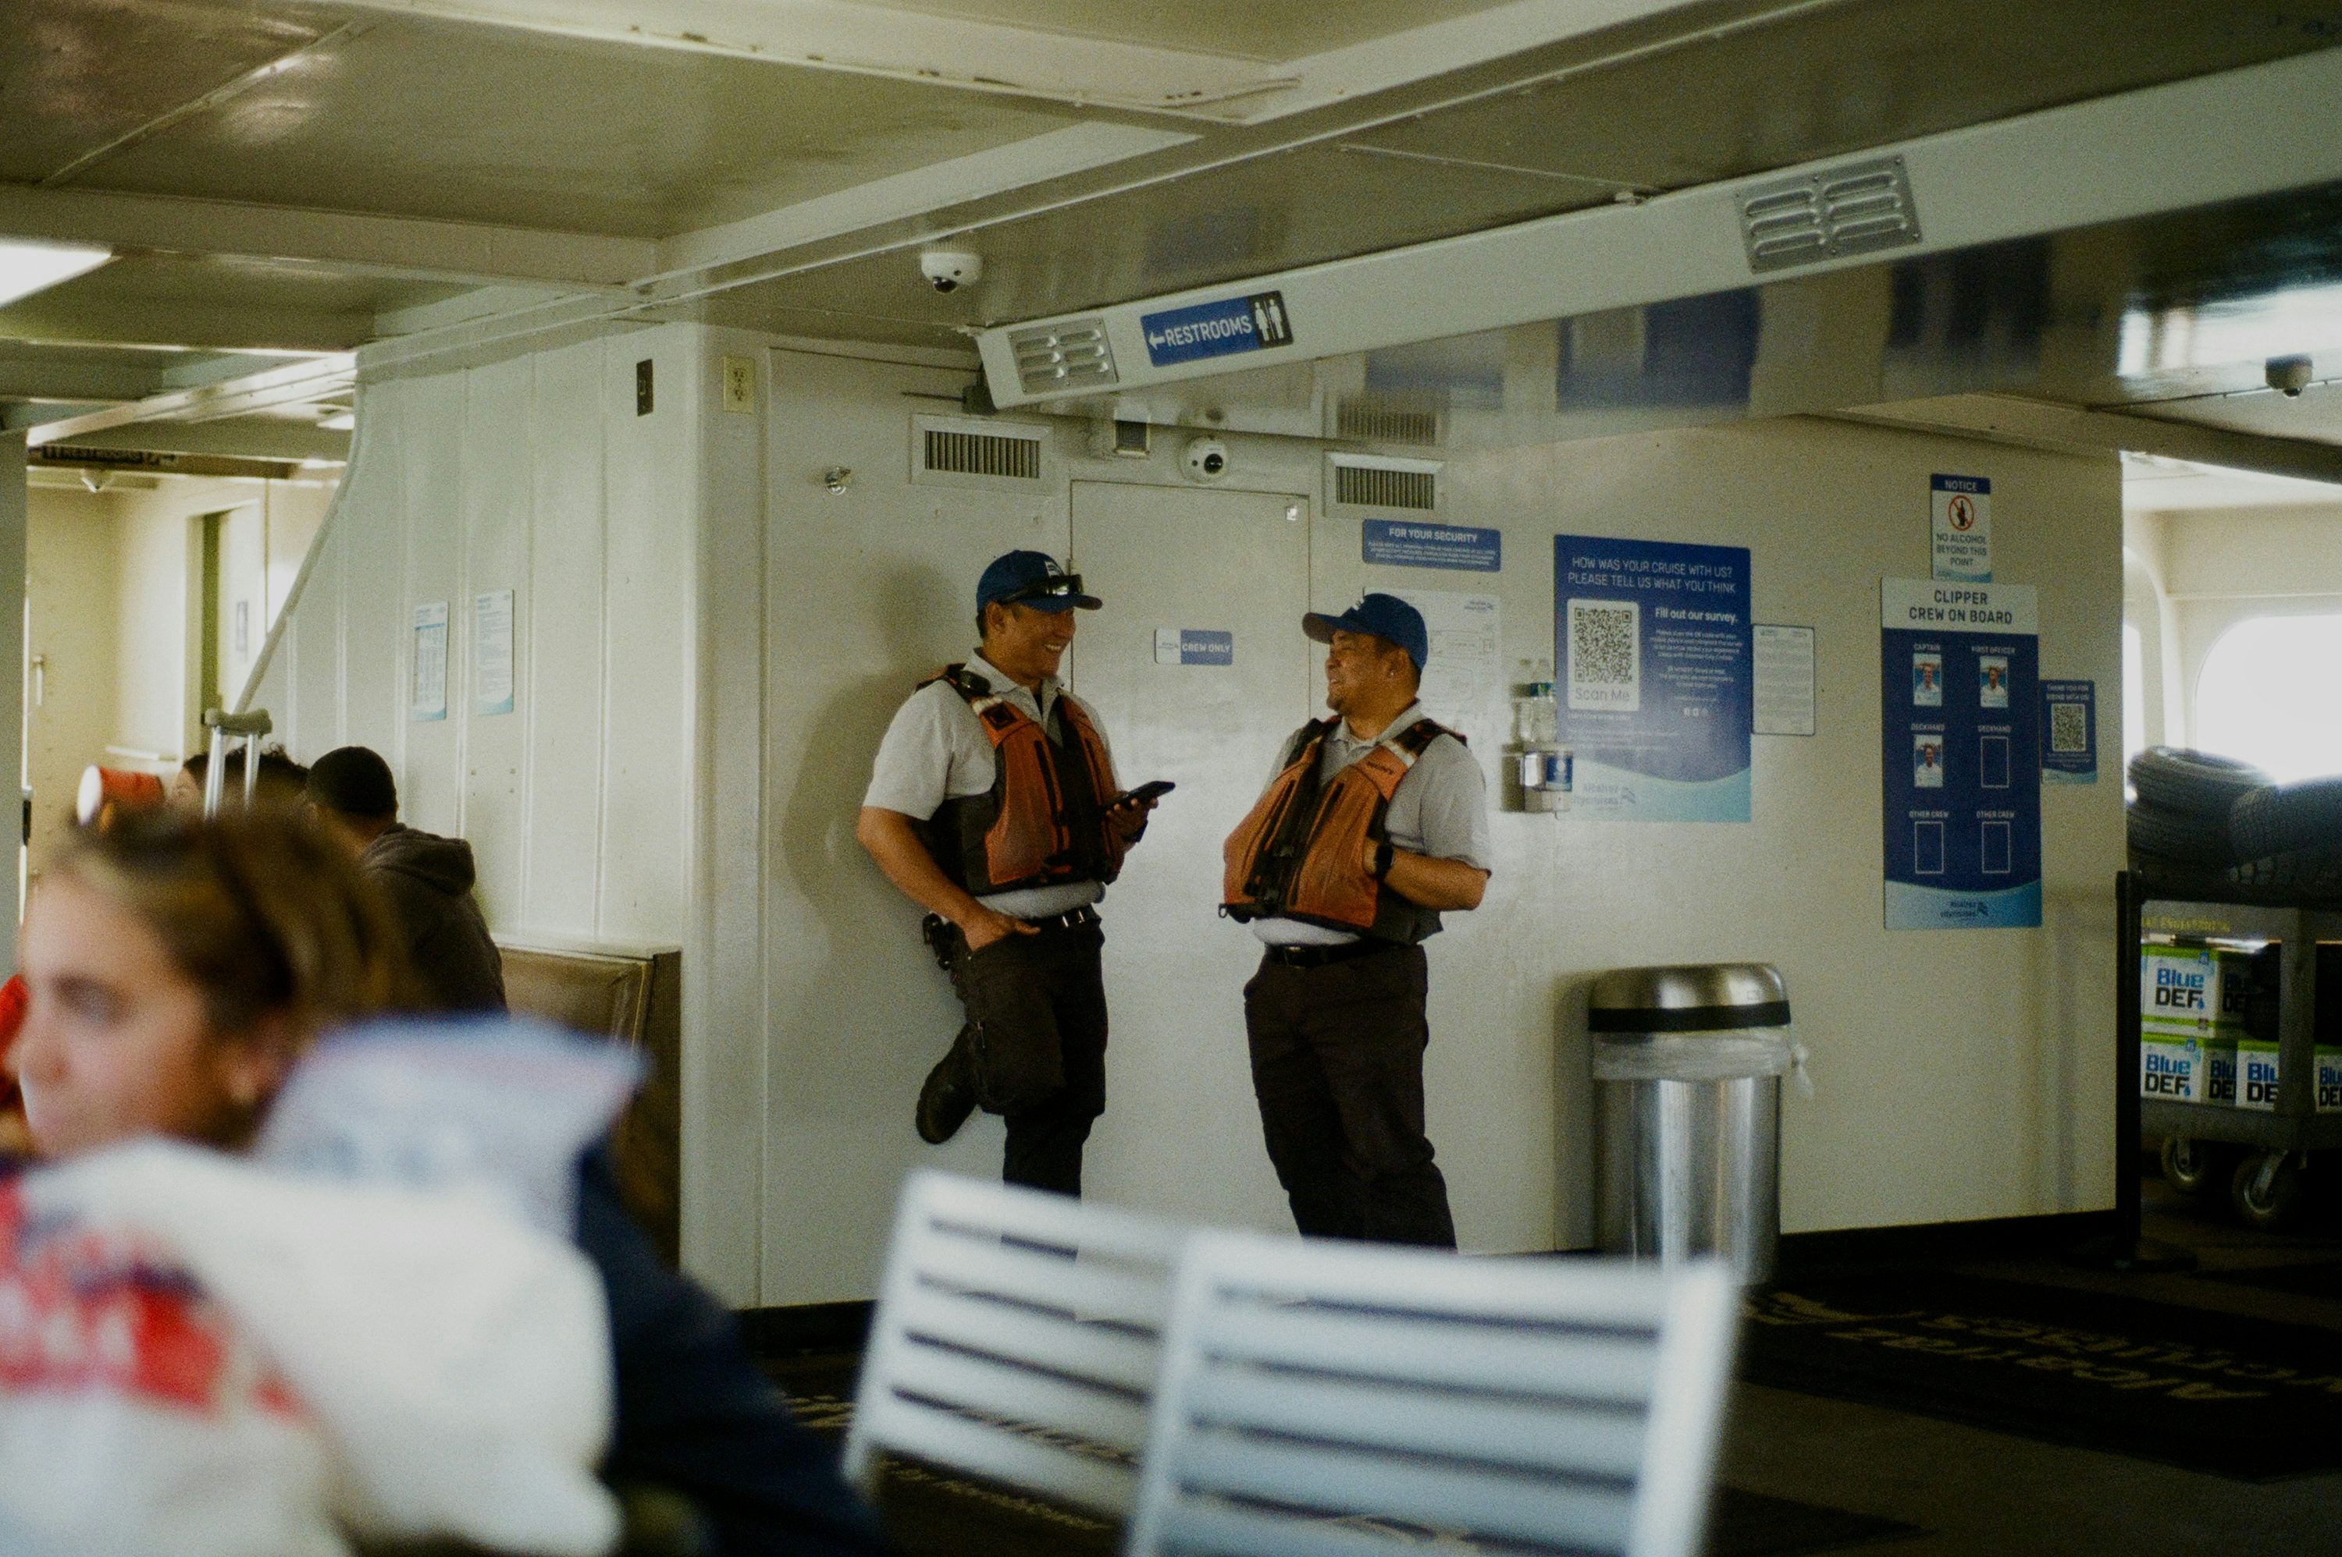



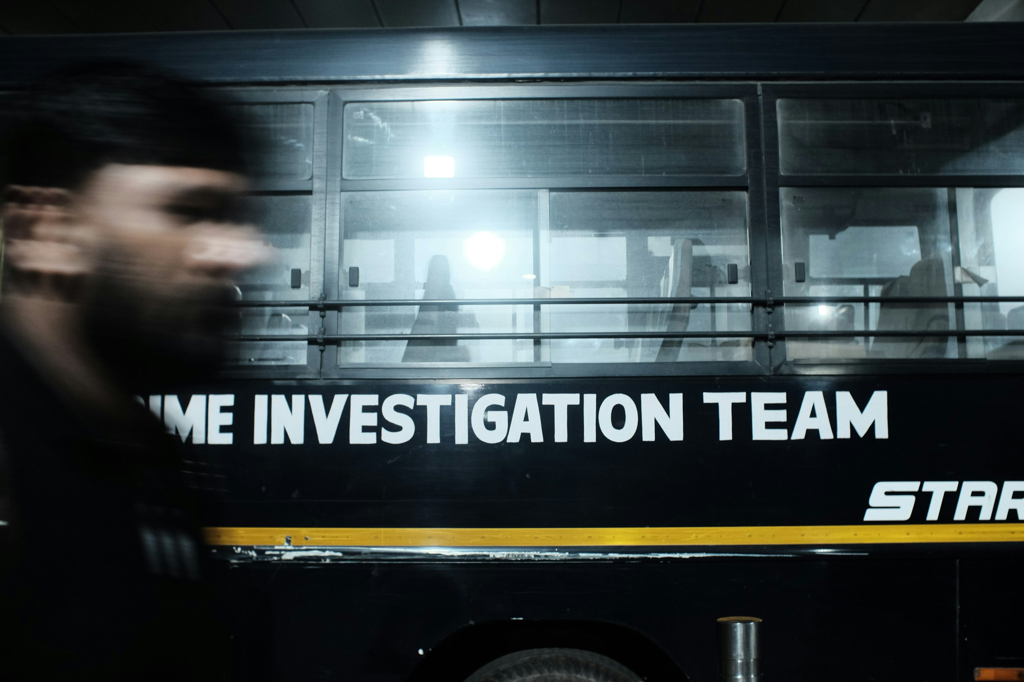
Because this...
Isn’t the same
as
that

Slide 19
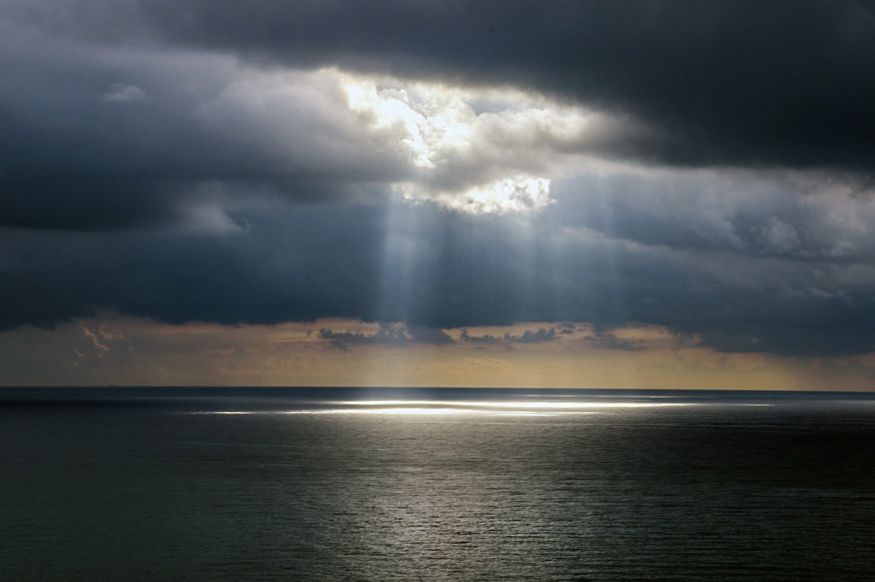
What is
THE DEATH ON THE HIGH SEAS ACT?
(DOSHA)

Slide 20


Slide 21


Slide 22


What the cruise lines lead you to think they provide
VS What you often get!

Slide 23

on the High Seas
...Exposed the lack of effective regulations to control crimes on the High Seas, saying...
“When wrongdoing occurs, no single agency within a country or specific international organization typically has a sufficient stake in the matter to pursue it." and "Prosecutions for crimes at sea are rare” — one former USCG official put it
at “less than 1%” — Additionally,
.
New York Times
July 2015...
...Many ship captains are averse to
the delays and prying that can
come with a police investigation!

Slide 24
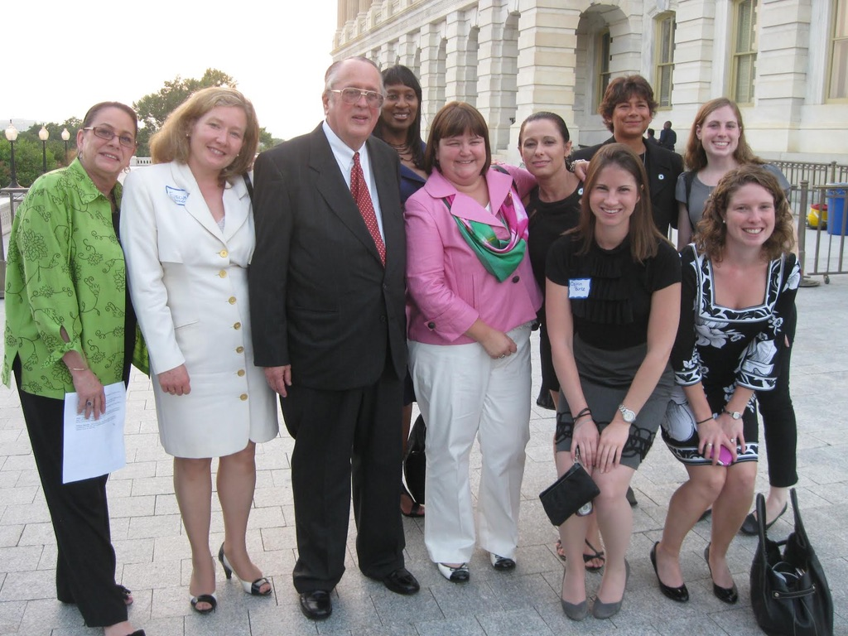
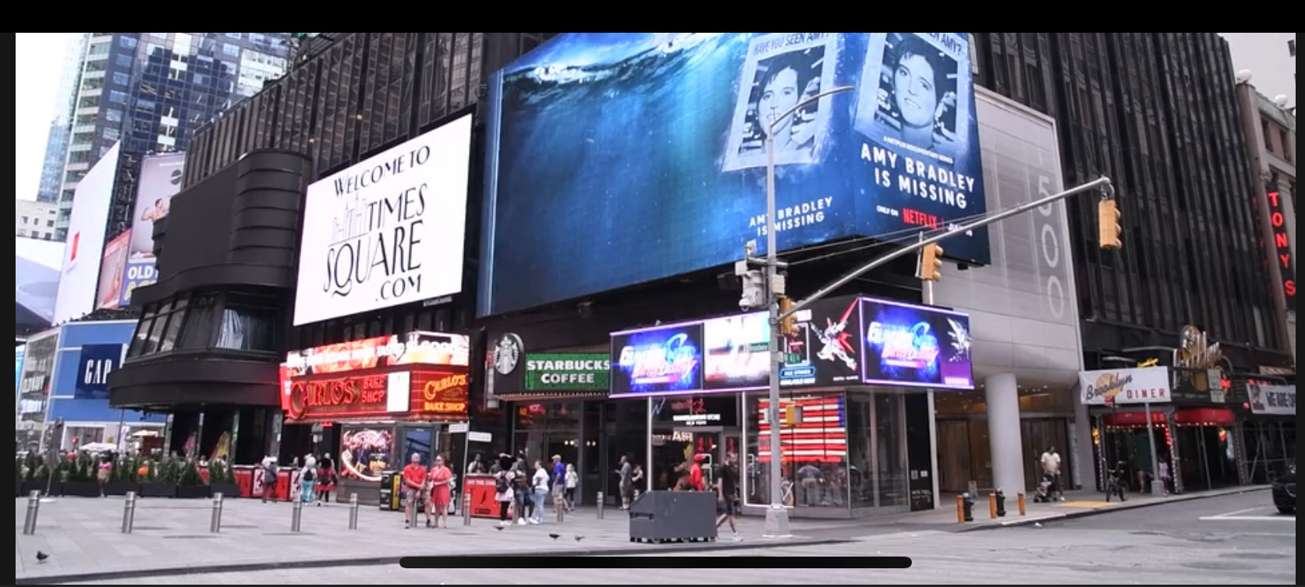
So What Is ICV Doing about These things?
- Pushing for enforceable legislation like
the CVSSA and the CPPA
- Supporting survivors and families
- Raising public awareness and
media advocacy
Notes:
We know now ICV fights back by raising awareness, lobbying lawmakers, and creating a support network for victims. We work closely with media, legal experts, and international partners to push for systemic change.

Slide 25

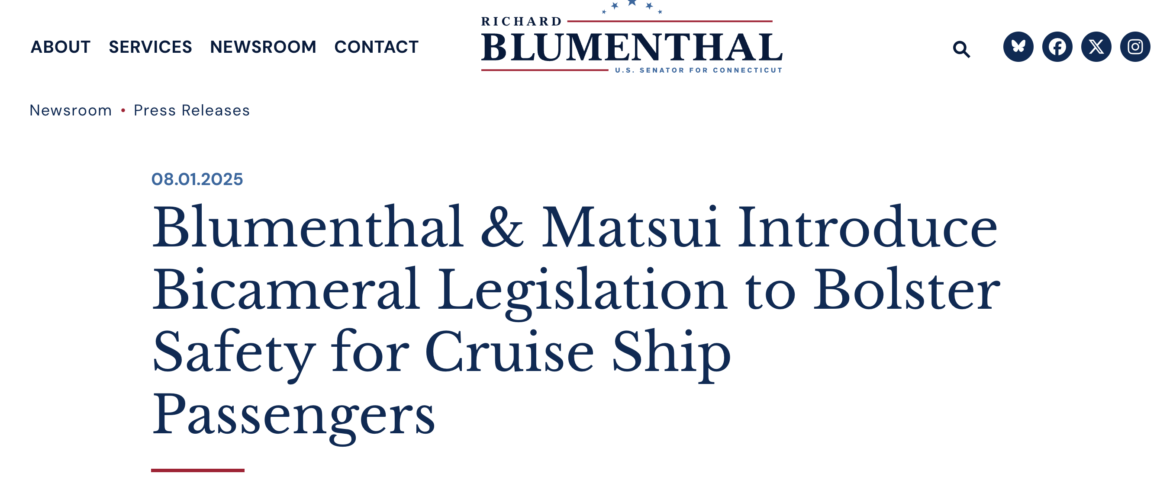

Slide 26
[WASHINGTON, D.C.] – Today, U.S. Senator Richard Blumenthal (D-CT) and U.S. Representative Doris Matsui (D-CA) introduced the Cruise Passenger Protection Act, legislation to improve the safety and well-being of cruise ship travelers. The legislation, known as S. 2640 and H.R. 4857, ensures that passengers are fully aware of their rights before they board the ship and provides them with a means of seeking recourse should their rights be violated.!

Slide 27
In addition to informing passengers of their rights prior to booking a cruise, the Cruise Passenger Protection Act implements a number of measures to strengthen passenger safety, such as those that expand crime reporting and prevention, bolster enforcement measures for violations of the law, and improve medical standards.
The Cruise Passenger Protection Act is endorsed by the International Cruise Victims Association (ICV).

Slide 28
“The ICV strongly supports the newly reintroduced legislation aimed at protecting the safety, dignity, and fundamental rights of cruise ship passengers. Recent events have once again brought to light the cruise industry’s systemic failure to prevent and respond appropriately to crimes, accidents, medical emergencies, and other life-threatening incidents at sea. Survivors and families too often find themselves navigating trauma, uncertainty, and institutional silence—with little or no access to justice. We call on all Members of Congress to support this critical legislation and stand with the victims, survivors, and families who are asking only for protection, justice, and accountability,”
said Jamie Barnett, Laurie Dishman, and Georgia Ananias of ICV.

Slide 29
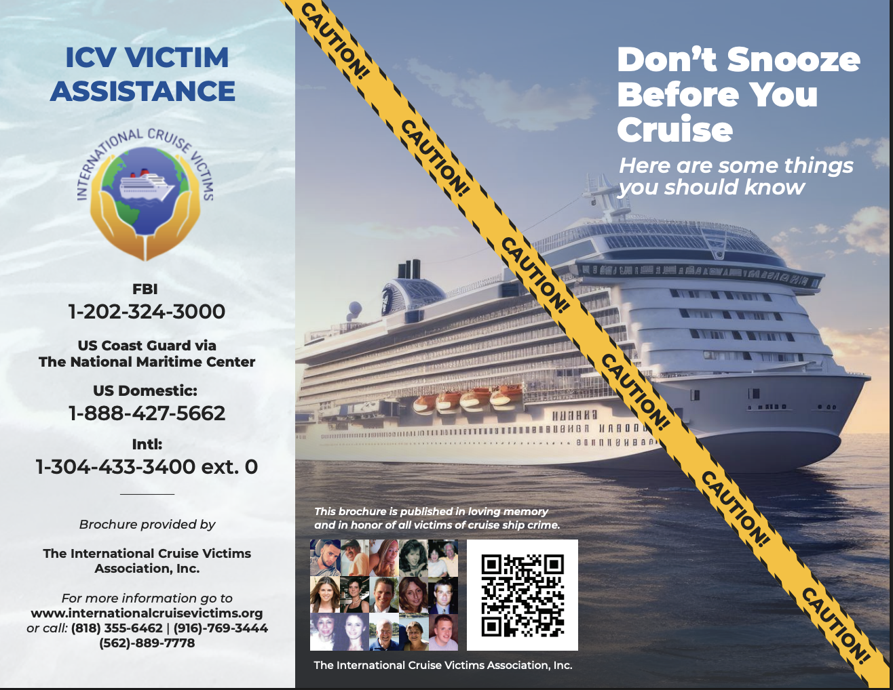

Slide 30
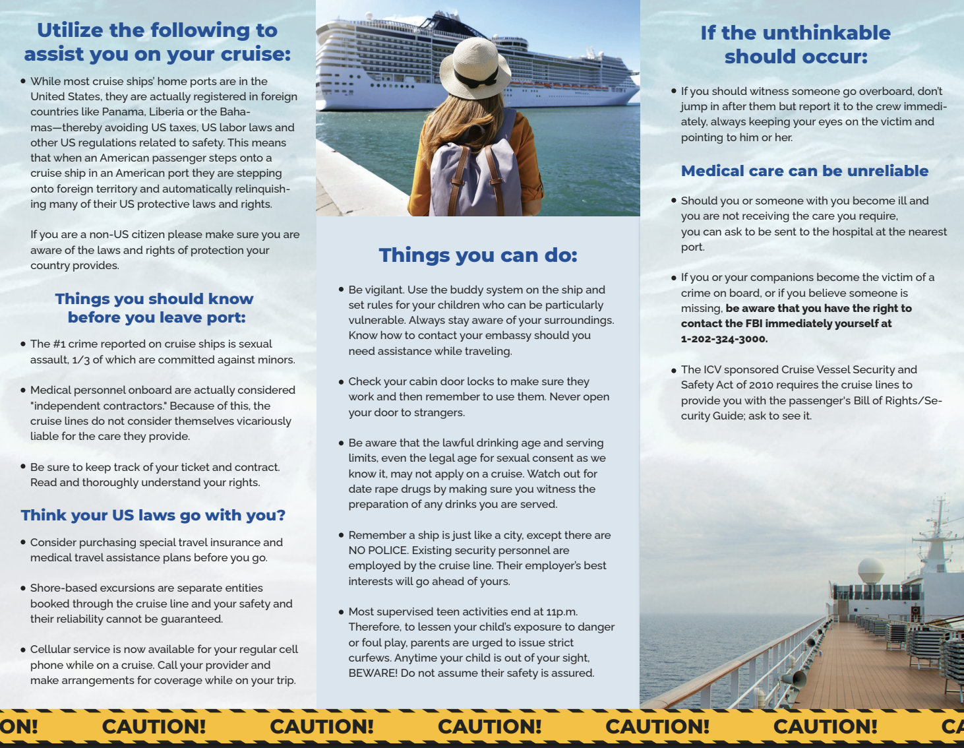

Slide 31

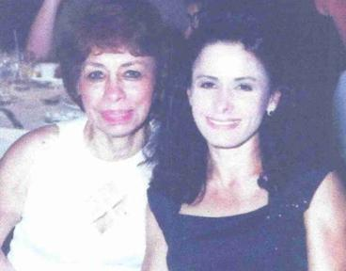

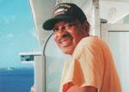
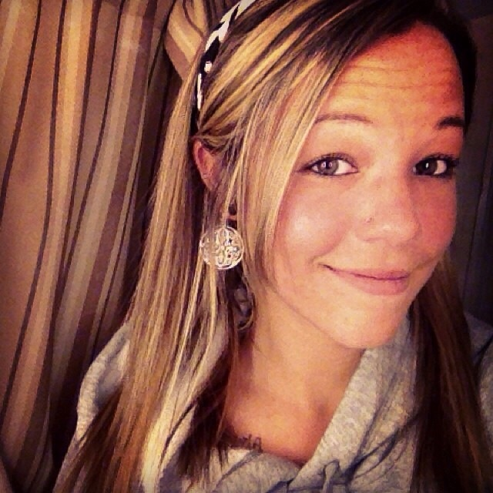


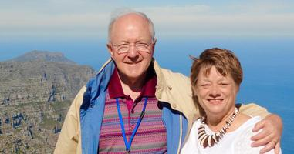
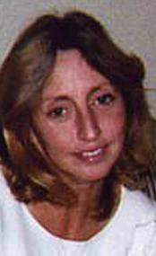

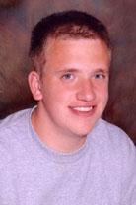
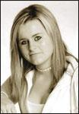
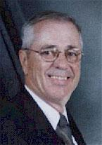

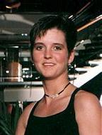
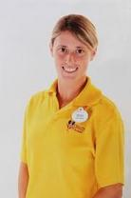

We Do What We Do for those who have been harmed and for those we have loved and lost; by speaking out on their behalf, especially those who no longer have a voice, we work and strive for justice for them with hope that our efforts will prevent our stories from becoming your story.
LOST AT SEA
Notes:
But we, Laurie, Georgia, and I are only 3 , among the multitudes of victims with tragic stories to tell, however, if you go on our website you will be able to see and discover how similarly all victims are treated by the wealthy, rapacious cruise industry. Which leads us to the main reason we are here today.
The other then says what is in the frame

Slide 32
