Slide 1

Dedicated to protecting and serving victims of crime and other tragic
events at sea
Since 2006

Slide 2

to advocate for improved regulations, standards and protocols that ensure the safety of cruise ship passengers, to increase the public's awareness of the potential risks as well as the rights and protections they are relinquishing to travel on a cruise ship, and… to provide support for passengers who have been the victims of crime, violence, negligence or other tragedies while on a cruise voyage.
The Mission of ICV is Threefold:

Slide 3
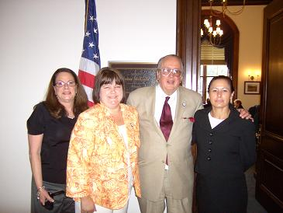


What ICV Does, Part I:
Advocates for improved regulations,
standards and protocols that ensure
the safety of cruise ship passengers
and crew.
The cruise industry has increased in size dramatically, yet cruise companies are largely unregulated and unaccountable for protecting passengers from crime and for assisting passengers after crimes have been committed. Together, our united efforts in support of legislation can more effectively counter the cruise industry’s extensive and self-promoting lobbying efforts. By gathering and circulating more accurate information on the cruise industry’s false claims, we can assist Congress with successfully regulating the cruise industry.

Slide 4
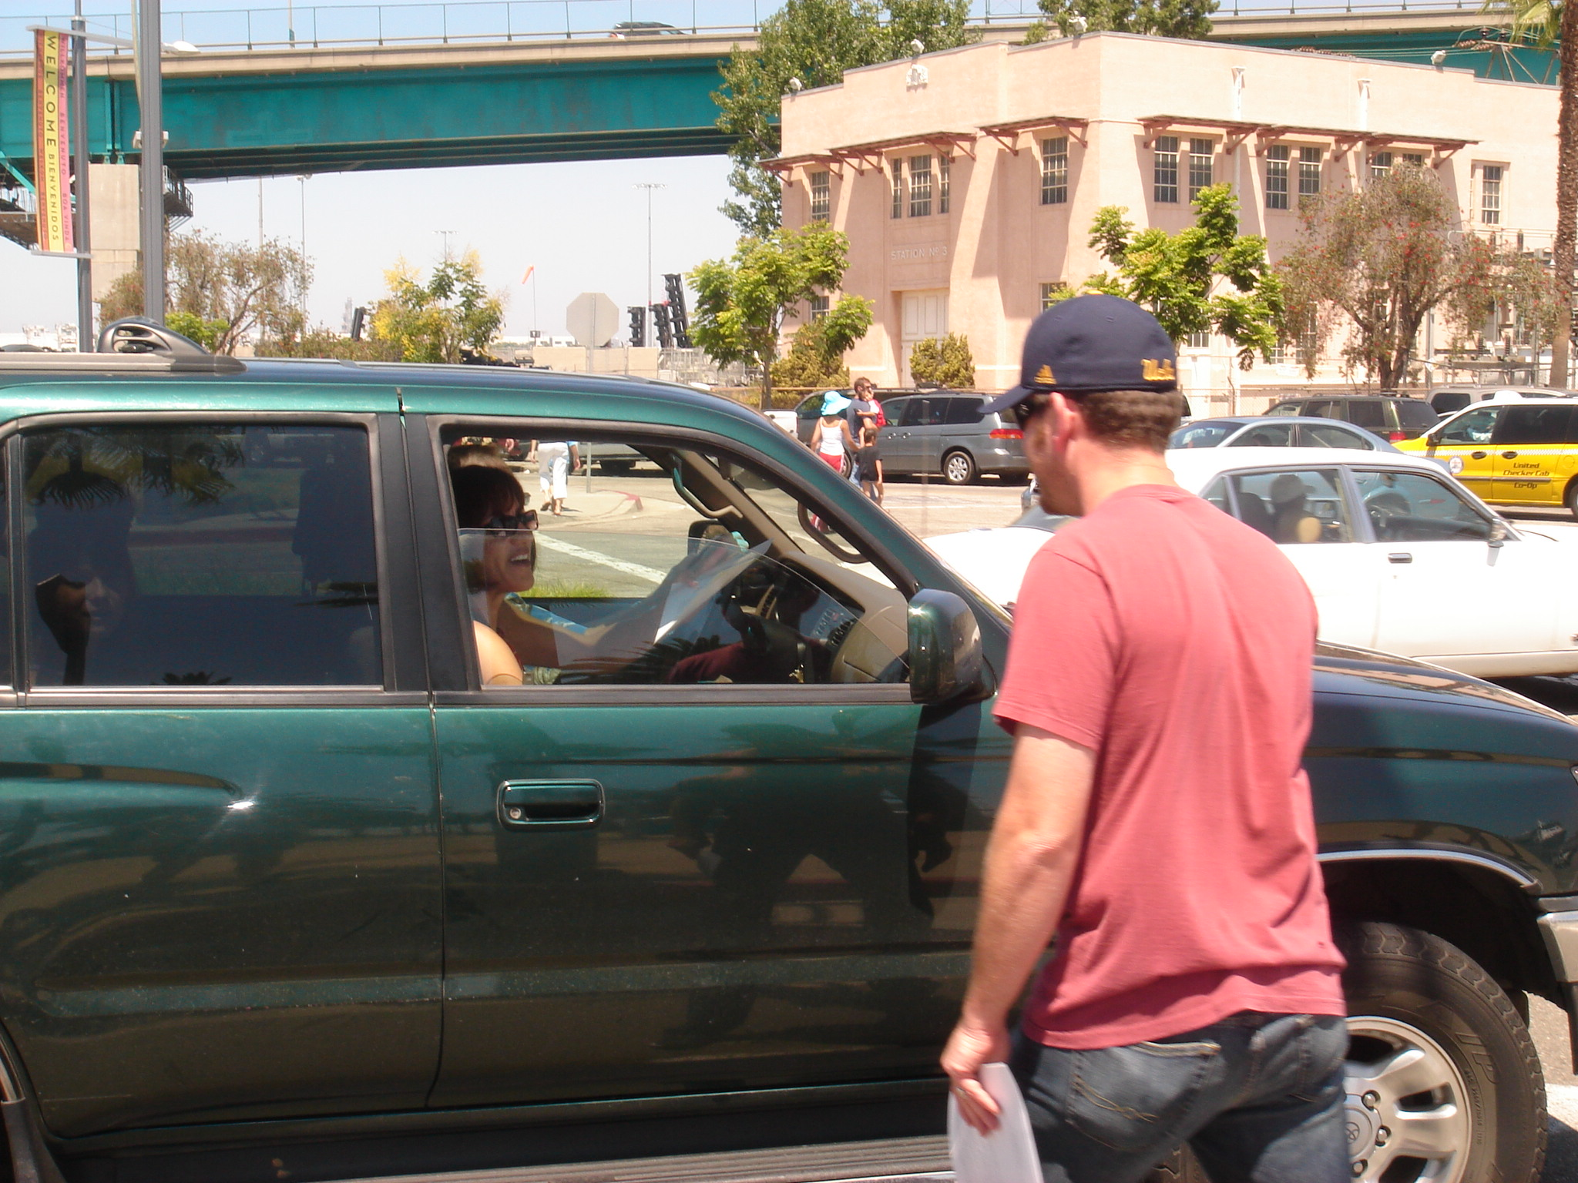
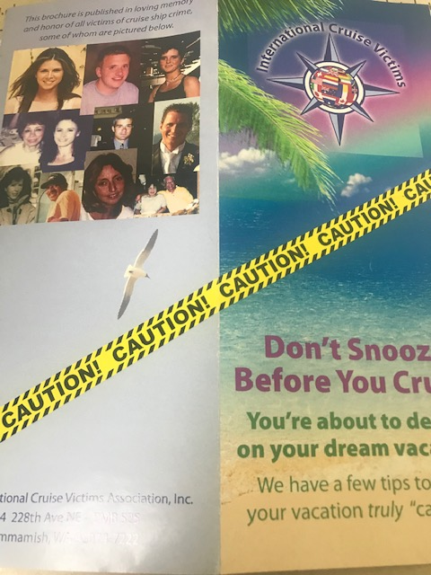
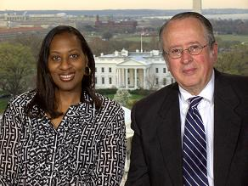
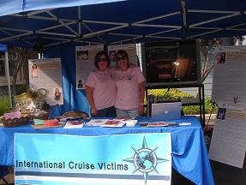
What ICV Does: Part II
Increases Public Awareness
As a 501c3 nonprofit organization, ICV works diligently to connect with other advocates around the world engaged in the fight for human rights and an increase in justice. We seek to strengthen public awareness of the issues at hand by disclosing the risks and perilous dangers to one’s personal health and wellbeing inherent in cruising, such as the possible exposure to disease, incidents of violence and crime, substandard medical care and more.

Slide 5

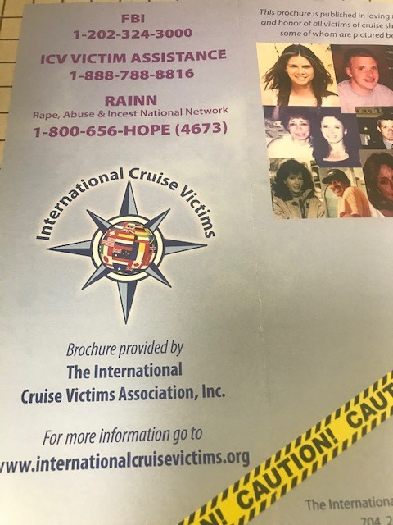
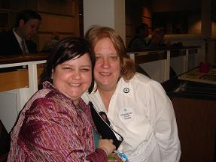
What ICV Does, Part III:
Victim Support
Cruise ship passengers who have had crimes committed against them often feel alone and frustrated by the jurisdictional uncertainties and poor treatment by cruise companies.
Our goal is to provide assistance to these victims in any manner possible. Sometimes, just talking with someone who has “been there” and understands is enough.

Slide 6
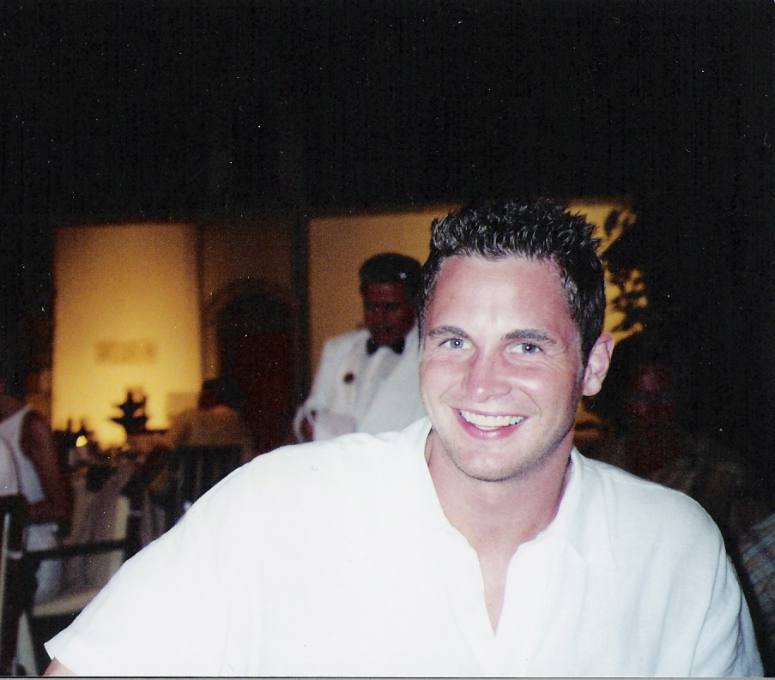
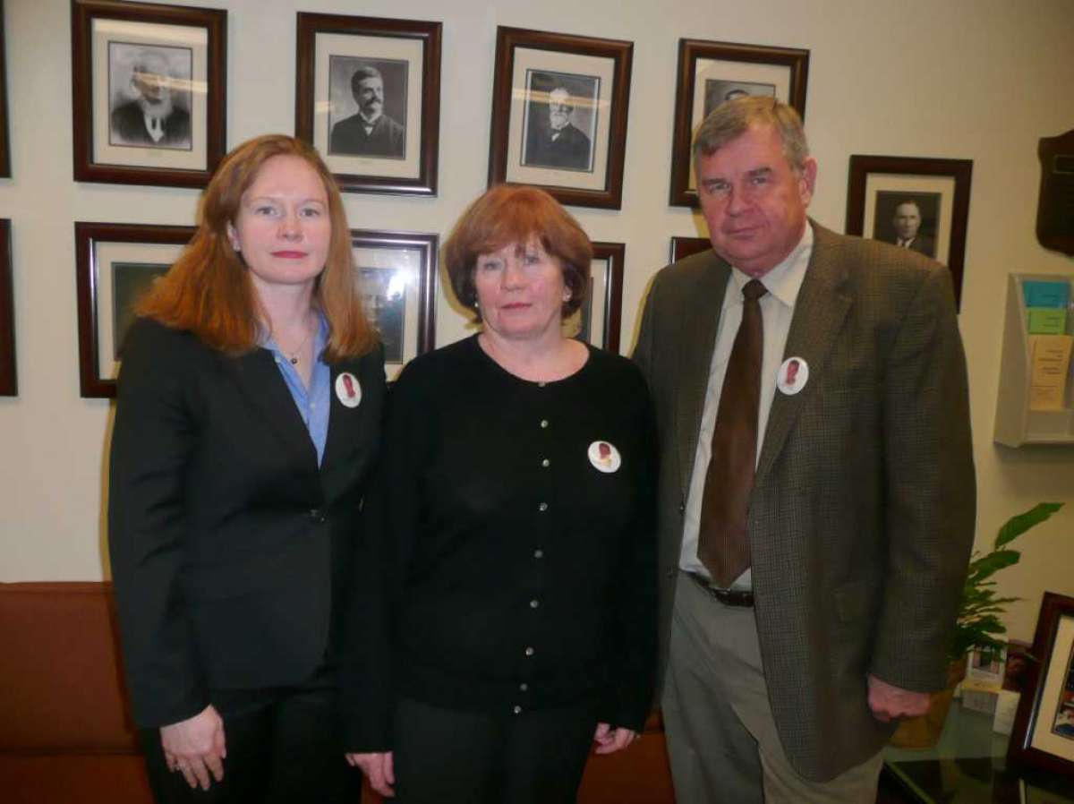
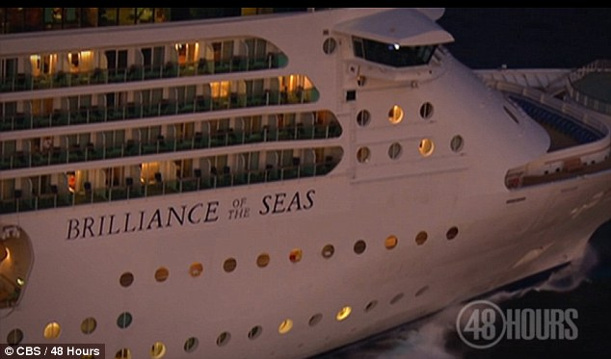
How We Began
George Smith IV, from Greenwich, Connecticut. Died near Turkey while on his honeymoon cruise vacation aboard the Brilliance of the Seas, July 5, 2005
George’s family

Slide 7


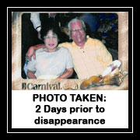
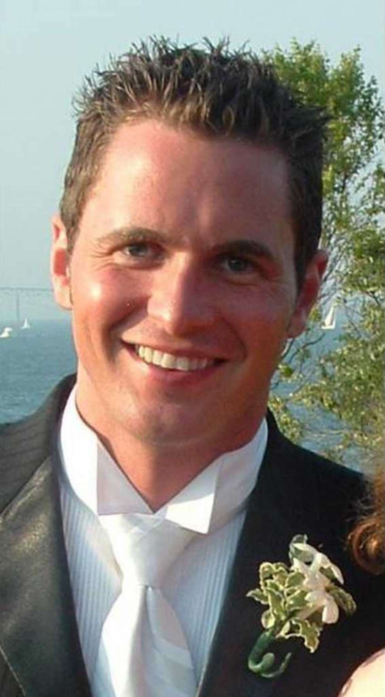
Four families, having lost loved ones, came together for the first time at a House hearing in December of 2005, chaired by Congressman Christopher Shays of
Connecticut.
James Scavone
Merrian Carver
Hue Pham & Hue Tram
George Smith lV
Disappeared 7/5/99
Carnival “Destiny”
Disappeared 8/24/04
“Celebrity “Mercury”
Disappeared 5/05
“Carnival “Destiny”
Disappeared 7/5/05
RCCL “Brilliance of the Seas
As a result, two more hearings were held in the House; one chaired by Rep. Shays again in March of 2006 and another in March of 2007 this time chaired by
Rep. Elijah Cummings.

Slide 8
CRIMES AGAINST AMERICANS ON CRUISE SHIPS
HEARING
BEFORE THE
SUBCOMMITTEE ON
COAST GUARD AND MARITIME TRANSPORTATION
OF THE COMMITTEE ON TRANSPORTATION AND INFRASTRUCTURE
HOUSE OF REPRESENTATIVES ONE HUNDRED TENTH CONGRESS FIRST
SESSION
March 27, 2007
Congresswoman Doris Matsui: (Laurie Dishman’s representative):
“These incidents beg the question: What is the process when
a crime is committed on a cruise ship, and what recourse do
passengers have?
The more I have inquired, the more I have been alarmed that
there is no shortage of cases of rape, sexual assault of
minors, alcohol-related fighting and abuse, and persons
overboard. Ever more troubling, most of these incidents have
not been fully resolved or prosecuted. The onion it seems has
only more layers to peel back.
Laurie's case was declined for prosecution under
circumstances that strongly suggest Federal authorities did not
fully investigate her case and that cruise industry
representatives have coached the crew member in his testimony.
I have since learned that there have been no convictions of
rape cases on cruise lines in four decades, a statistic that
takes on a new meaning through the lens of Laurie's experience.
Continued…..

Slide 9
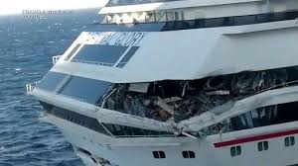

“Cruise industry executives testified last year before the
House Government Reform Committee that 66 cases of sexual
assault were reported by Royal Caribbean between 2003 and 2005.
However, as a result of a civil suit, Royal Caribbean was
forced to turn over internal documents that showed that the
numbers were actually much higher, specifically, the number was
273. I have also come to learn that crimes that were not
reported involved minors. It seems impossible that Royal
Caribbean would not consider these crimes worthy of reporting.
This time around I want to know whether the industry has
accurately depicted the number of sex crimes on ships, and how
it chooses to define the crimes.
And …
Americans who go on cruise ships for a family vacation have no idea they may be stepping into a situation in which U.S. law has little power and where they may be victims of a crime without recourse. Cruises operate in a legal vacuum, where lack of accountability empowers predators and obstructs their victims' pursuit of justice. That is an unacceptable situation, made worse by the cruise lines' own efforts to block scrutiny of and accountability for their own handling and security of their passengers. “

Slide 10
In response to Rep. Matsui, Congresswoman Brown from the state of Florida offered this:
“The cruise industry is highly regulated by the State, Federal, and international laws. They ensure that their passengers are safe and have a sound, safe, and secure record.”
The Ranking Member of the full Committee on Transportation and Infrastructure,
Mr. Mica, also from Florida defended the cruise industry as well saying:
“Ms. Brown mentioned the safety of cruise ship activities and of an individual on a cruise ship versus major metropolitan areas. I have some of the actual statistics. One of the safest places in the world to be is on a cruise ship, and the statistics will prove it.
We have made some progress. I commend the cruise industry, the FBI, the Coast Guard for working on a protocol to improve the reporting of crimes and accidents involving Americans on cruise ships. Implementation of this protocol I am hopeful will address the concerns of the cruise ship industry critics and also hopefully address some of the delays that have lead to the failure to prosecute crimes and to find accident victims in a timely manner.

Slide 11

Irony of all Ironies…
In December of 2017, a federal judge sentenced U.S. Rep. Corrine Brown to five years in prison after a jury convicted the Florida Democrat of fraud for using a charity for poor students as her personal expense account.

Slide 12
But then, one of our greatest champions, Congressman Elijah Cummings said,
“Thank you, Ms. Matsui, I want to be very clear. We are going to revisit this issue in six months. In six months, I hope that the parties will get together and work together and see where we can build on, what we can build on. Mr. Dale --Mr. Kaye said there are certain things that are already being done. I want to know what those are. I want to know what things happen from this day forward, particularly since there is an agreement now in place. And to Mr. Carver and Ms. Dishman, we want you to stay in contact with our staff, so that we can move this along. I am convinced, I am thoroughly convinced that we can make a difference. All of us coming together as Americans, we have a can-do Country. We can do this. Thank you very much. “

Slide 13
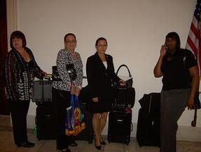
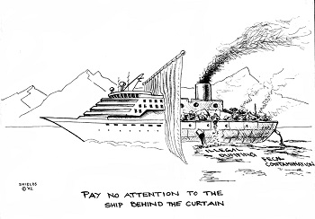
So off the two parties went to Miami
ICV vs
CLIA

Slide 14
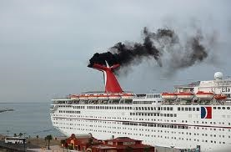

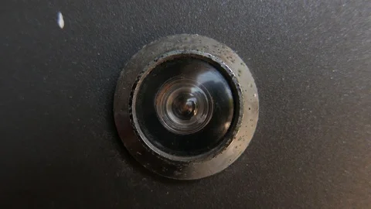

Agreed to
Not even…
So…

Slide 15

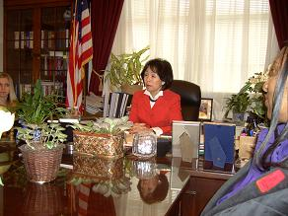
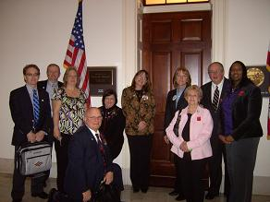
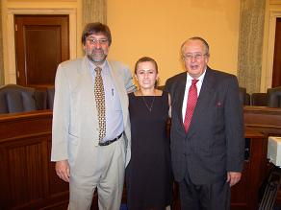
Back to Washington DC
For 2 more hearings, Sept. 2007 & June 2008

Slide 17
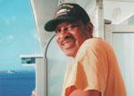
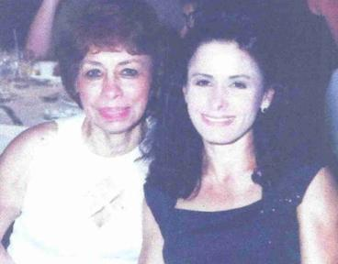







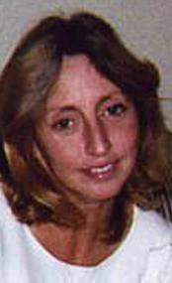


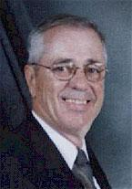

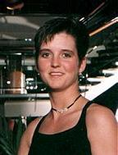

We Do What We Do for those who have been harmed and for those we have loved and lost; by speaking out on their behalf, especially those who no longer have a voice, we work and strive for justice for them with hope that our efforts will prevent our stories from becoming your story.
LOST AT SEA

Slide 18

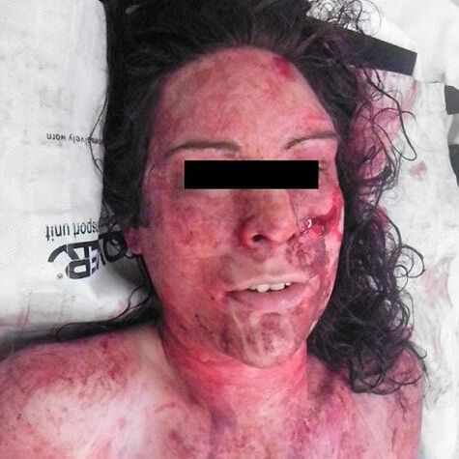


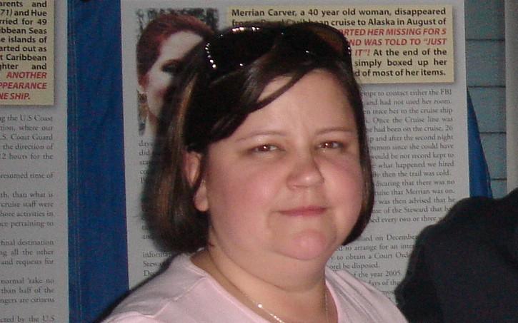
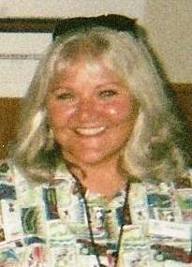
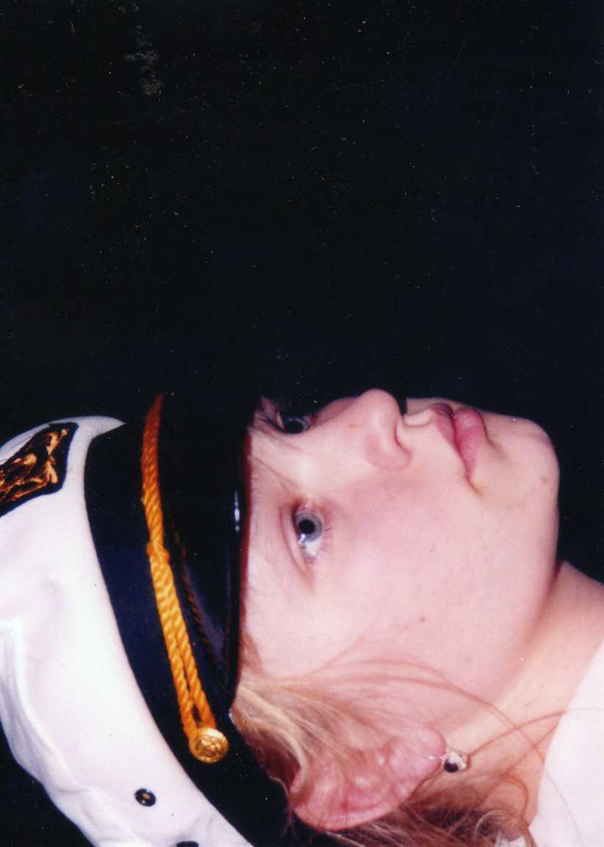
SURVIVORS OF CRUISE SHIP SEXUAL ASSAULT
Did not survive
SEXUAL ASSAULT
is the
# 1
Crime occurring
on
cruise
ships!!
Age
12

Slide 19
The Road from Victim to Victorious
Our stories, as well as new incidents of cruise ship crime, begin to get media attention.
During several meetings in Miami, ICV presents a 10-step plan to CLIA but gets no commitments for improvements by the cruise lines. Congress declares legislation is necessary and Doris Matsui (CA-D) and Ted Poe (TX-R) introduce a bi-partisan bill in the House, CVSSA.
A companion bill is introduced in the Senate by John Kerry.
Other victims’ advocacy groups support the ICV cause.
High level meetings with USCG, FBI, and the DOJ.
ICV members use their own resources to promote the cause, while CLIA spends $11 million in 2008 and 2009 to promote theirs.

Slide 20
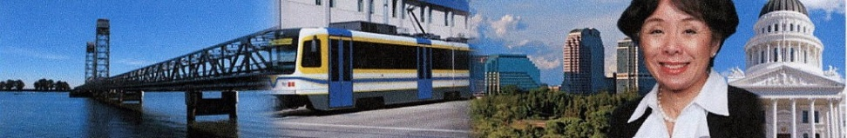

Victory in the House
November, 2009
416-4
Victory in the Senate
June, 2010
Unanimous Consent

Slide 21
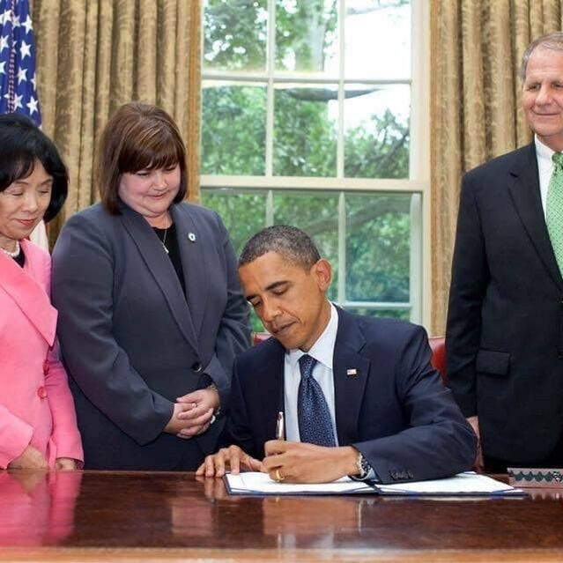
July 27, 2010
The Cruise Vessel Security and
Safety Act
became…
From left to right:
Rep. Doris Matsui (D-CA)
ICV Member – Laurie Dishman
POTUS – Barack Obama
Rep. Ted Poe (R.- TX)

Slide 22
Cruise Vessel Security and Safety Act or
CVSSA Summary
* The new law requires the cruise industry to install video surveillance systems in common areas as well as door viewers and security latches on cabin doors. The ship railings must be at least 42” in height and a safety guide must be distributed to each passenger detailing the contact information for proper authorities everywhere the ship sails.
* Each ship must carry equipment and materials to perform sexual assault medical exams and to collect forensic evidence. Ships also need to have drugs to prevent sexually transmitted diseases after an assault.

Slide 23
Cruise Vessel Security and Safety Act
Summary
* The new bill also contains a clause insuring medical confidentiality with provisions forbidding the master of the vessel from passing on the confidential medical records of sexual assault victims to company officials, particularly the corporate legal department without the victim’s consent.
* Ships will be required to log and report all deaths, missing persons, alleged crimes and complaints involving most thefts, sexual attacks and assaults involving U.S. citizens. Those records must be available to the FBI and the U.S. Coast Guard electronically and to all law enforcement officers.

Slide 24
Cruise Vessel Security and Safety Act
Summary
* Additionally, each cruise line must provide a link to this crime reporting web site on its own web site.
* And finally, the law provides for civil and criminal penalties to be assessed against any vessel in violation of the above provisions.

Slide 25
But, and there is a big BUT, ICV has learned the hard way that one cannot rest there. The work continues.

Slide 27
The Cruise Passenger Protection Act would:
Require vessels to integrate technology that can be used for capturing images of passengers AND detecting passengers who have fallen overboard, to the extent that such technology is available;
Improve medical standards aboard cruise ships.
Require vessels to be staffed with an appropriate number of sea marshals, who have been certified by, and are
operating under the jurisdiction of, the United States Coast Guard.
Establish the Department of Transportation (DOT) as the lead federal agency for consumer protection for cruise ship passengers, similar to the role the Department has in aviation consumer protection;
Give consumers a clear upfront summary of the restrictive terms and conditions in cruise contracts. The Secretary of Transportation would develop standards for the cruise lines to provide prospective passengers with a short summary of the key terms in the contract. Consumers would be able to read a plain language summary of the key rights and limitations that passengers have during their cruise so they are fully aware of what rights they have, and don't have, before they book their tickets.

Slide 28
CPPA continued….
Establish a consumer complaints toll-free hotline telephone number, give the DOT the authority to investigate complaints, and create an Advisory Committee for Passenger Vessel Consumer Protection, which would be charged with evaluating current consumer protections and generating recommendations for improvements;
• Require the reporting of crimes against minors to the list of currently reported crime statistics. • Address crimes on cruise ships by strengthening video surveillance requirements in public areas, and setting requirements for the amount of time cruises lines must retain videos; • Establish a victim advocate to be the primary point of contact in assisting victims, including helping the victim to understand their rights in international waters, get access to appropriate law enforcement and consulate services, and have access to necessary victim support services.

Slide 30
What would GCAN want Congress to include in new legislation, given that the world is ready to listen to the U.S. once again?!?!?

